Slide 1
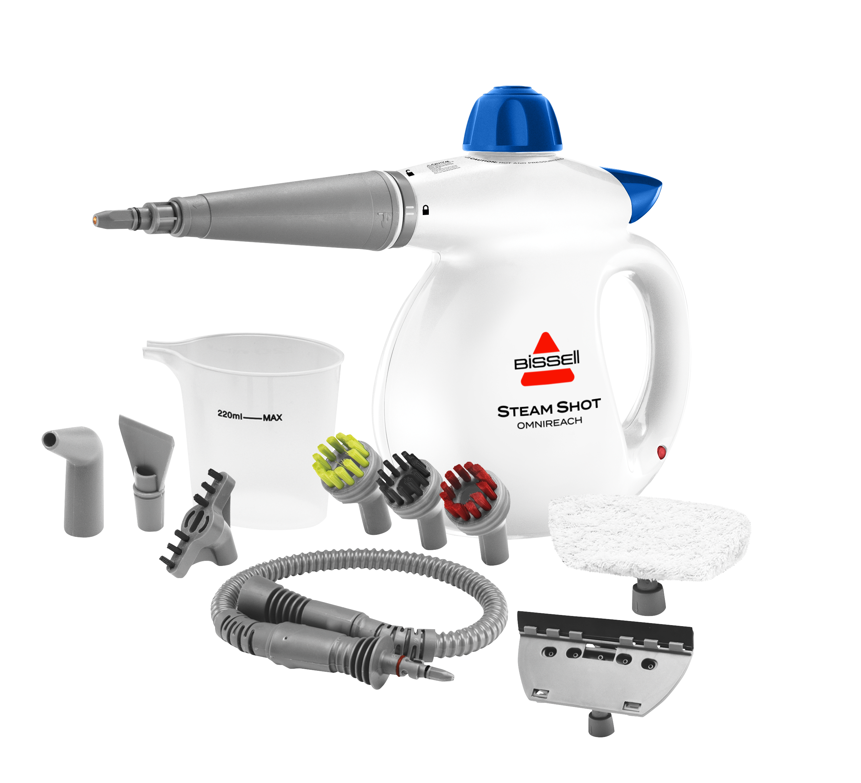
SteamShot™
OmniReach™
Features
High Pressure Steam
100% Chemical Free Cleaning
Cleans and Sanitizes with the Natural Power of Steam
Clean Across a Variety of Above Floor Surfaces
Safety Cap
Steam-on-Demand Trigger
Accessory Nozzle
OVENS & STOVETOPS
MICROWAVES
COUNTERTOPS & GROUT
360mL Water Tank
WINDOWS
PET BEDS
PET BOWLS
Indicator Light
INCLUDES
11 Multi-Surface Cleaning Attachments
Extra-Long Power Cable
*Retail pricing is at the sole discretion of the retailer.

